Slide 1
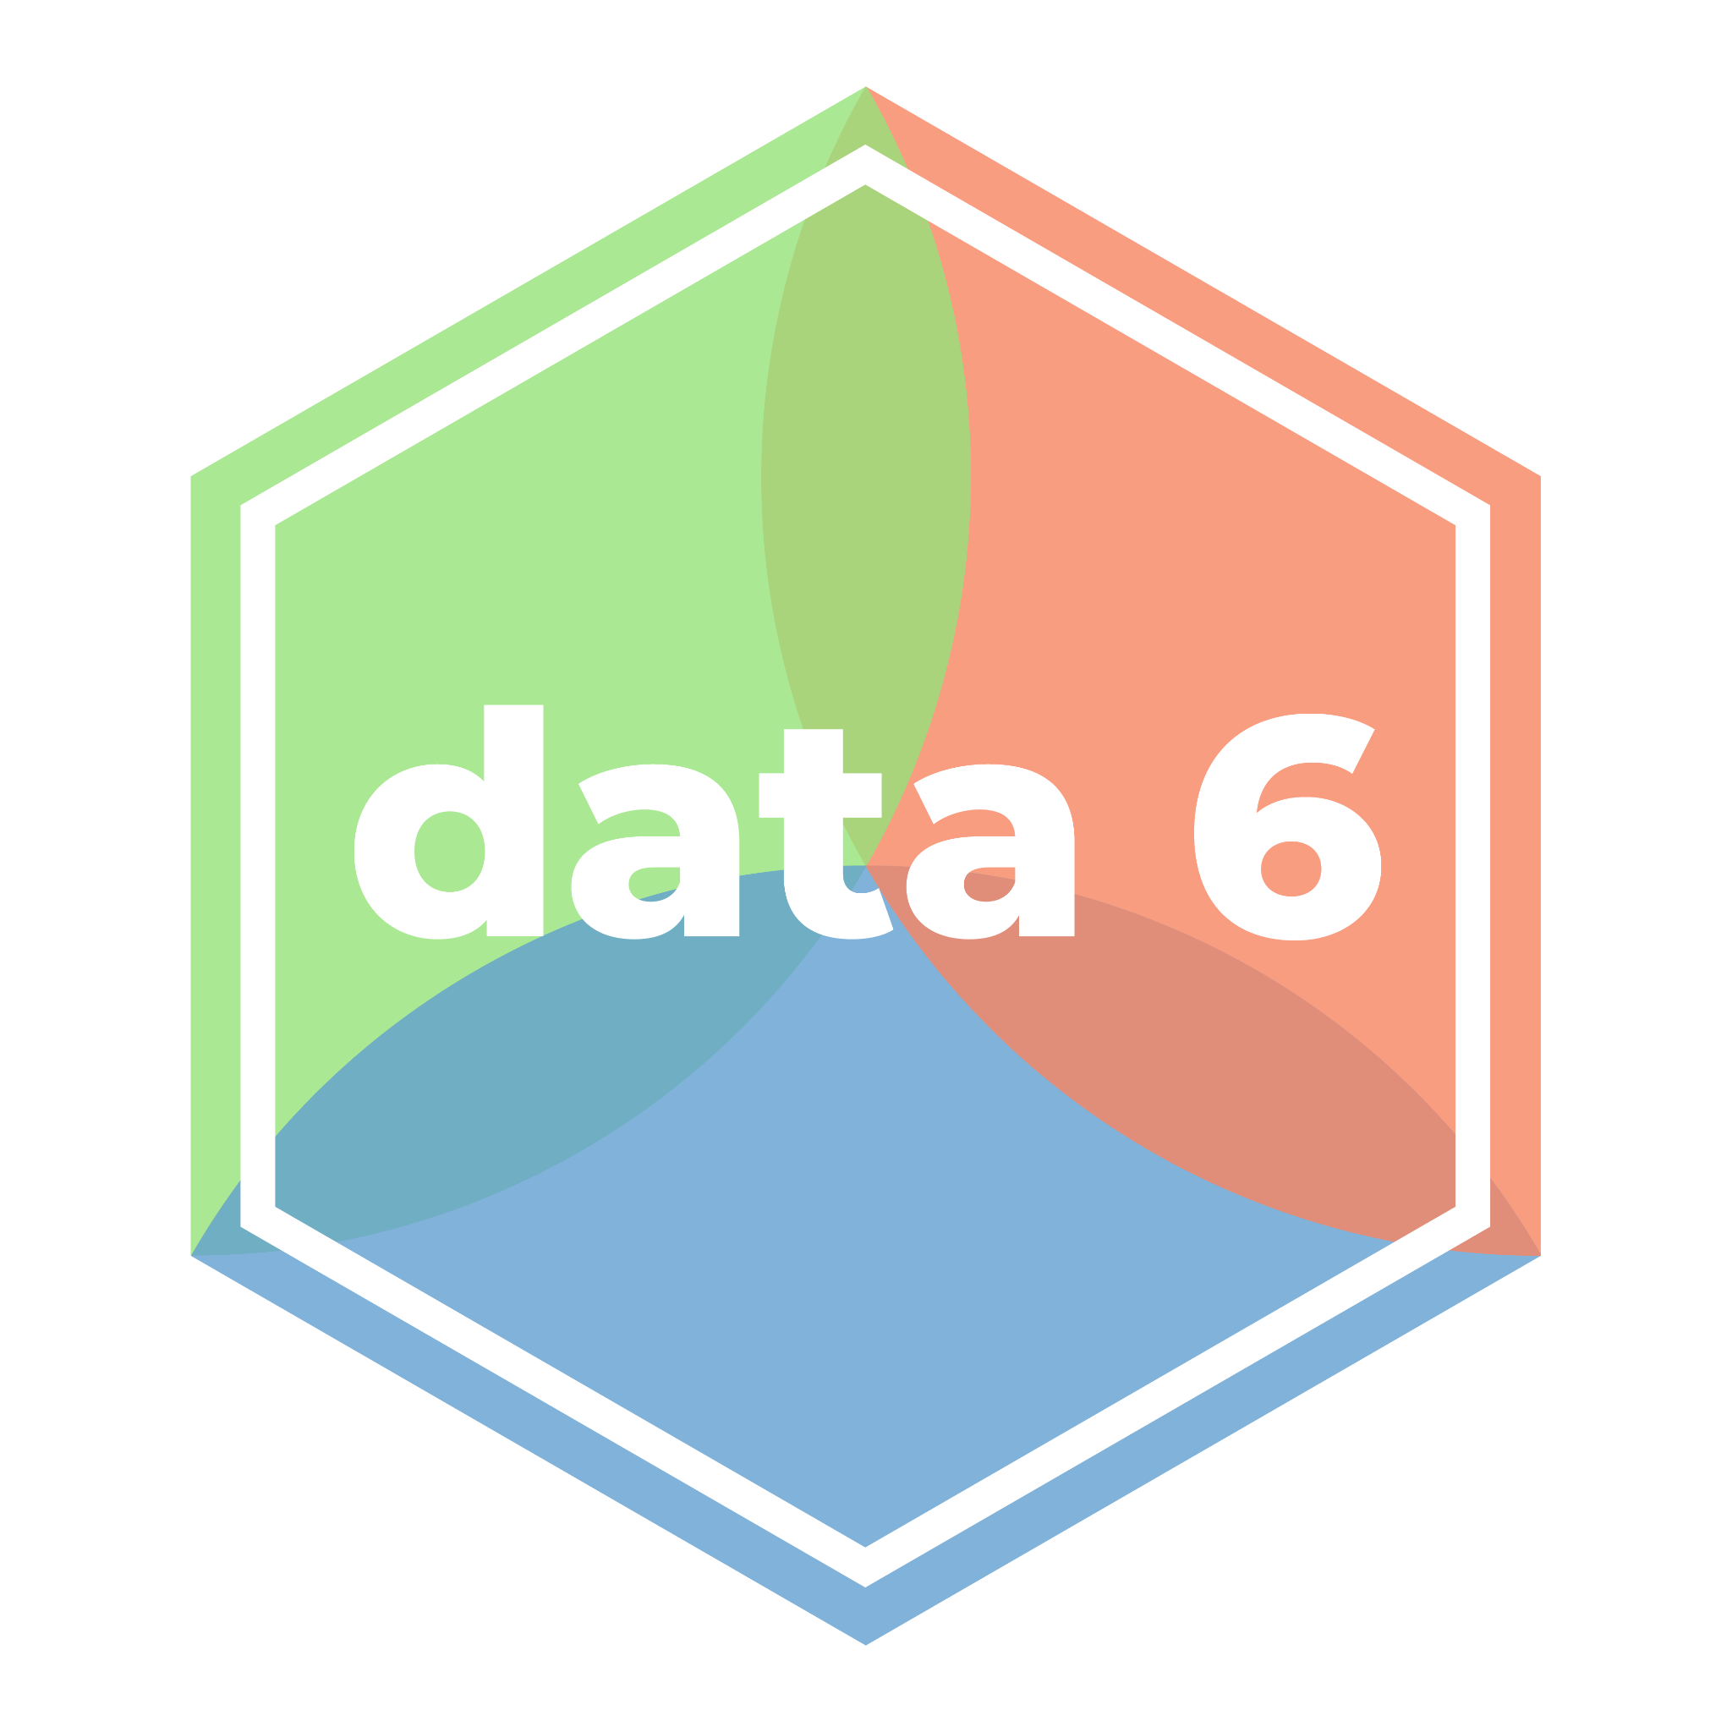
Visualizing Numerical Variables
LECTURE 12
All about histograms.
Spark 10 Spring 2024
Developed by students and faculty at UC Berkeley and Tuskegee University
data6.org/su23/syllabus/#acknowledgements-

Slide 2
Week ??
Announcements!
No Homework Due this week!
Mid-Semester Project will be announced soon/this week.
Will be similar to Homework #3
Will be due March 22
Office Hours take place
(Suzanne) Mondays 4:30 - 5:20PM in ACS 366
(Adrien) Wednesdays 4:30 - 5:20PM in ACS 330B
(Jordan) Tuesdays & Thursdays 10-12am

Slide 3
Today’s Roadmap
Review: Bar Charts
NumPy Array Ranges
Numerical Distributions, Histograms
Choosing Bins
Overlaid and Side-by-Side Histograms
Lecture 12, Spark 10 Spring 2024

Slide 4
Review: Bar Charts
➤
1. Review: Bar Charts
2. NumPy Array Ranges
3. Numerical Distributions, Histograms
4. Choosing Bins
5. Overlaid and Side-by-Side Histograms

Slide 5
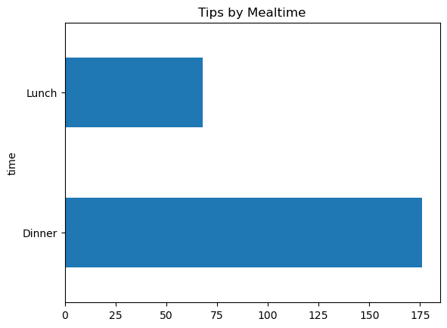
.plot.barh()
tips_by_mealtime = tips['time'].value_counts()
ax=tips_by_mealtime.plot.barh(x='time',title='Tips by Mealtime')

Slide 6
NumPy Array Ranges
1. Review: Bar Charts
2. NumPy Array Ranges
3. Numerical Distributions, Histograms
4. Choosing Bins
5. Overlaid and Side-by-Side Histograms
➤

Slide 7
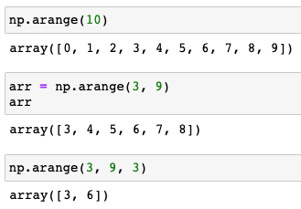
np.arange()
The NumPy function np.arange() creates a sequence of numbers.
Format | Returns
np.arange(n) | An array of all integers from 0 to n-1.
np.arange(start, stop) | An array of all integers from start to stop-1.
np.arange(start, stop, step) | An array of all integers from start to stop-1, counting by step.
Array ranges work like indexing: inclusive of the starting position, and exclusive of the ending position.

Slide 8
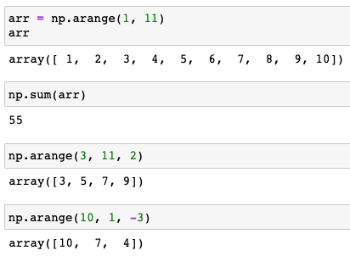
Array Range Examples
Negative steps work as well!

Slide 9
Quick Check 1
What will the following cells output?
In [ ]:
np.arange(5)
In [ ]:
np.arange(3, 13, 3)
In [ ]:
2 ** np.arange(8)
In [ ]:
np.sum(np.arange(4)** 2)

Slide 10
Numerical Distributions, Histograms
1. Review: Bar Charts
2. NumPy Array Ranges
3. Numerical Distributions, Histograms
4. Choosing Bins
5. Overlaid and Side-by-Side Histograms
➤

Slide 11

Towards Numerical Distributions
Bar charts visualize the distribution of a categorical variable, or the relationship between a categorical variable and one or more numerical variables.
Bar charts cannot display the distribution of a numerical variable.
Question: How might we display the distribution of a numerical variable?
Answer: One solution is to combine ranges of values into bins.

Slide 12
Binning
Binning is counting the number of numerical values that fall within ranges, called “bins”.
A bin is defined by a left endpoint (lower bound) and right endpoint (upper bound).
A value falls in a bin if it is greater than or equal to the left endpoint and less than the right endpoint.
[a, b): a is included, b is not.
The width of a bin is its right endpoint minus its left endpoint.
72, 61, 63, 74, 68, 67, 65, 73, 65, 62, 66
Bin: [72, 76)
Width: 4
60
64
68
72
76

Slide 13
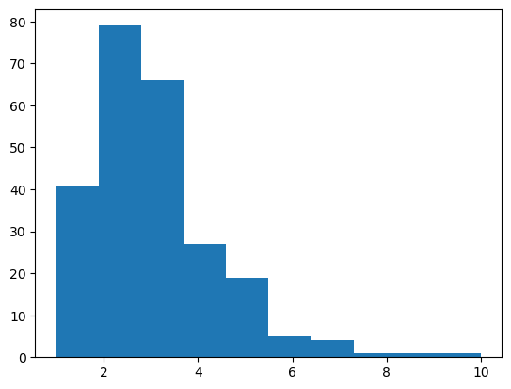
Histograms
tipValue = tips['tip']
plt.hist(tipValue)
A histogram visualizes the distribution of a numerical variable by binning. The method
plt.hist(column)
This column must contain numerical values.
It automatically chooses bins for us. We can change them.

Slide 14
Get the Data
We can also get the bin end points and the values (counts) plotted at each bin.
values, bins, plot = plt.hist(tipValue)
41 tips in the range [1,1.9)
print(values)
array([41.,79.,66.,27.,19.,5.,4.,1.,1.,1.])
sum(values)
244.0
sum(tipValue)
244
print(bins)
array([1.,1.9,2.8,3.7,4.6,5.5,6.4,7.3,8.2,9.1,10.])

Slide 15
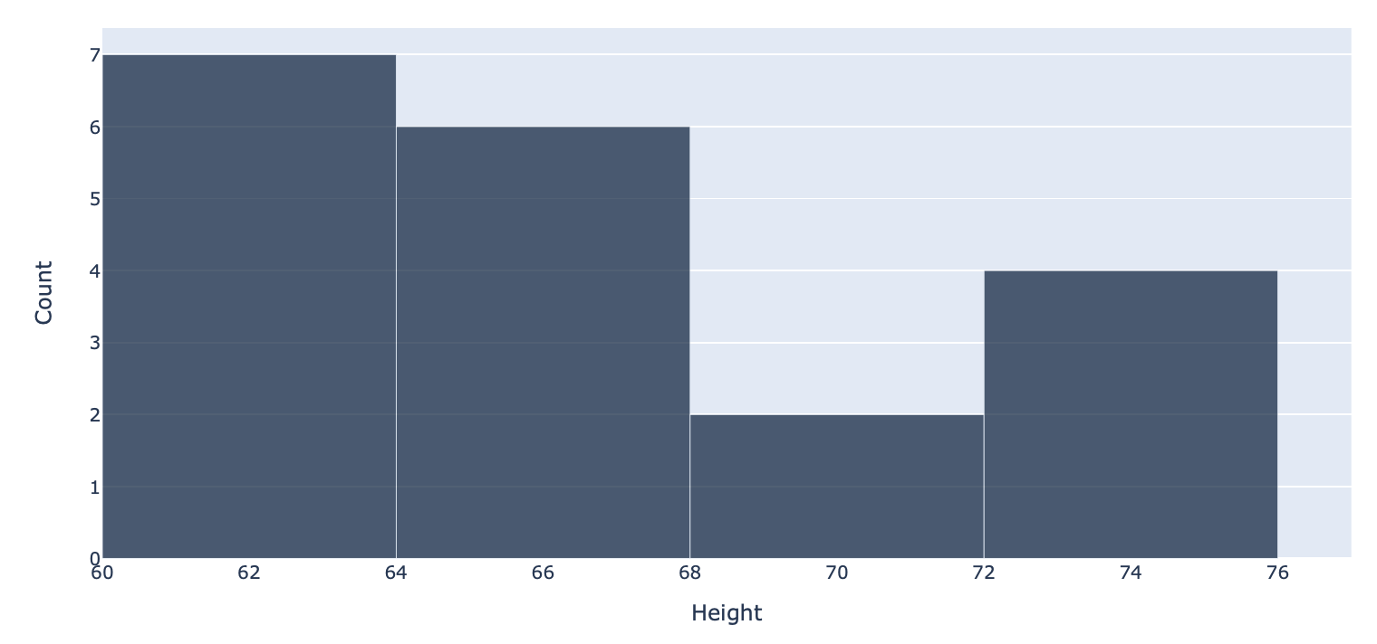
Quick Check 2
Answer the following about this histogram of (fake) heights. If you don’t believe it’s possible to answer the question, write “can’t tell”.
How many are between 60 inches & 64 inches?
How many heights are between 62 inches & 68 inches?

Slide 16
A Note on Bins
By looking at a histogram, we cannot tell how values are distributed within a bin.
All heights in this bin could be 64 inches.
Or they could all be 66 inches.
Or half could be 65 and half could be 67.
Unless we have the actual data, we can’t tell.

Slide 17
Choosing Bins
1. Review: Bar Charts
2. NumPy Array Ranges
3. Numerical Distributions, Histograms
4. Choosing Bins
5. Overlaid and Side-by-Side Histograms
➤

Slide 18
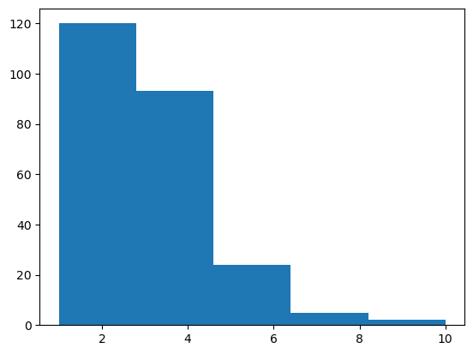
Bins
.hist chooses bins by default for us.
The resulting histogram often looks nice, but has non-integer bins which are harder for us to interpret.
We can choose our own bins.
We will only consider histograms where all bins have equal width, though it is possible to draw histograms where bins have unequal width.
values, bins, plot = plt.hist(tipValue,bins = 5)
The optional bins argument in hist can take a number of bins. (The default is 10.).

Slide 19
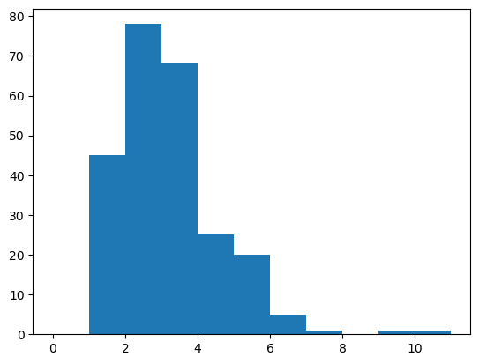
np.arange()
Same as np.array([0, 1, 2, 3, …, 11]).
You can also give an array that specifies the bin end points.
But if we want more than a handful of bins, it will be tiring to create them by hand. Instead, we can use np.arange to create an array of equally spaced values.
values, bins, plot = plt.hist(tipValue,bins = np.arange(12))

Slide 20
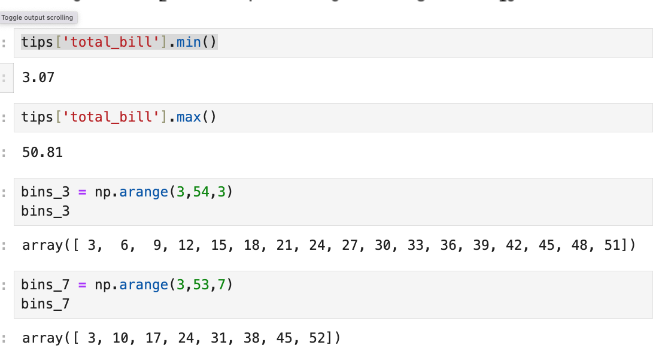
Example
It’s a good idea to determine the min and max values in a column before choosing bins, to make sure your bins encompass the entire range.
We need to make sure that the largest value in the column is part of one of our bins.
If we used
np.arange(3, 51, 3)
for example, the last two elements in bins_3 would be 45 and 48, meaning that the last bin is [45, 48), and 50.81 isn’t placed in a bin.

Slide 21
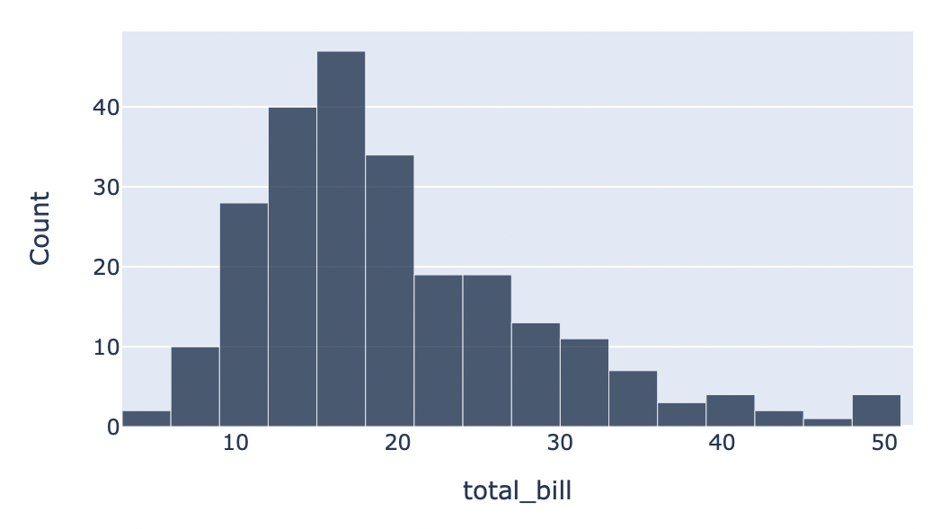
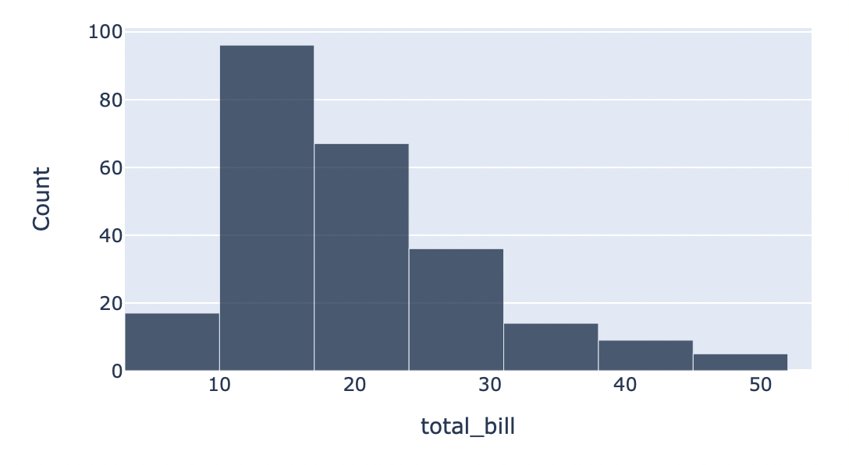
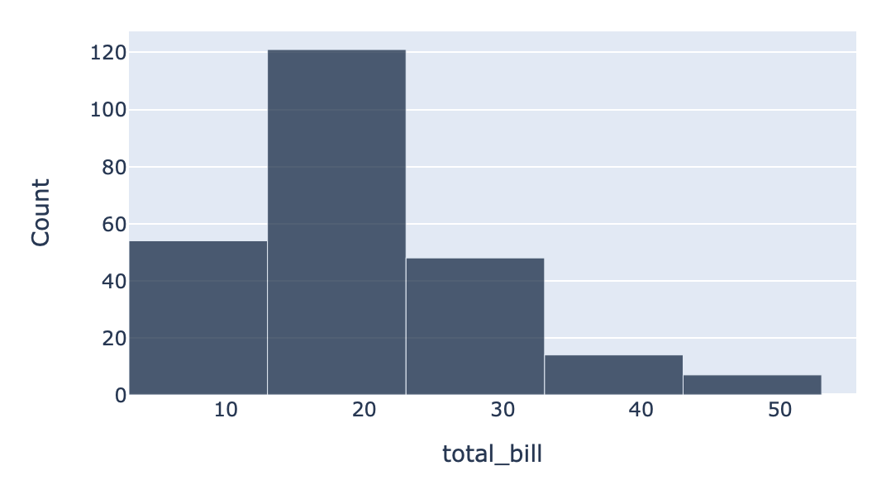
Tradeoff
The width of each bin used dramatically changes the resulting histogram.
Narrow Bins → many bins, each with few values. Resulting histogram is choppy.
Wide Bins → few bins, each with many values. Resulting histogram is smooth.
In practice, it’s up to you to choose the bin size of your histogram.
Width = 3
Width = 7
Width = 10

Slide 22
Overlaid and Side-by-Side Histograms
1. Review: Bar Charts
2. NumPy Array Ranges
3. Numerical Distributions, Histograms
4. Choosing Bins
5. Overlaid and Side-by-Side Histograms
➤

Slide 23
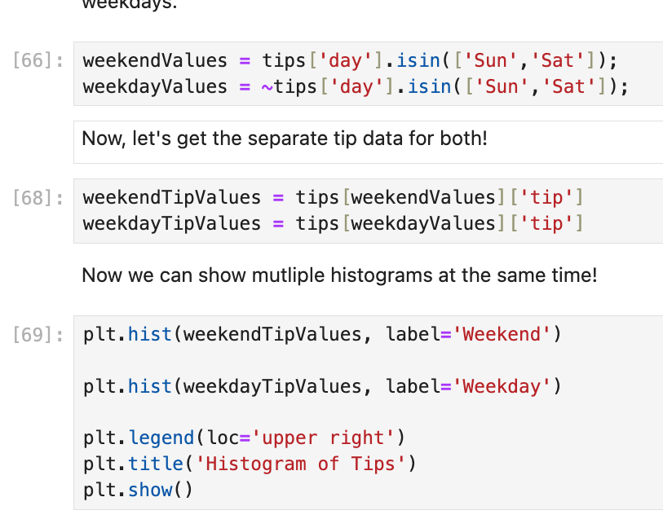
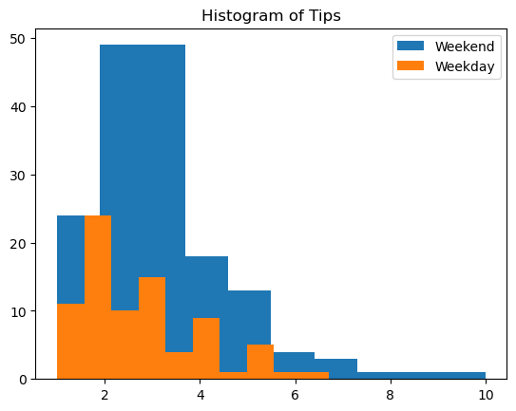
Combining Histograms
What if we want to show the distribution of a numerical variable, grouped by some categorical variable? For example, tips on weekends vs. tips on weekdays?
We will separate each category into its own array and overlay each plot with one another.

Slide 24
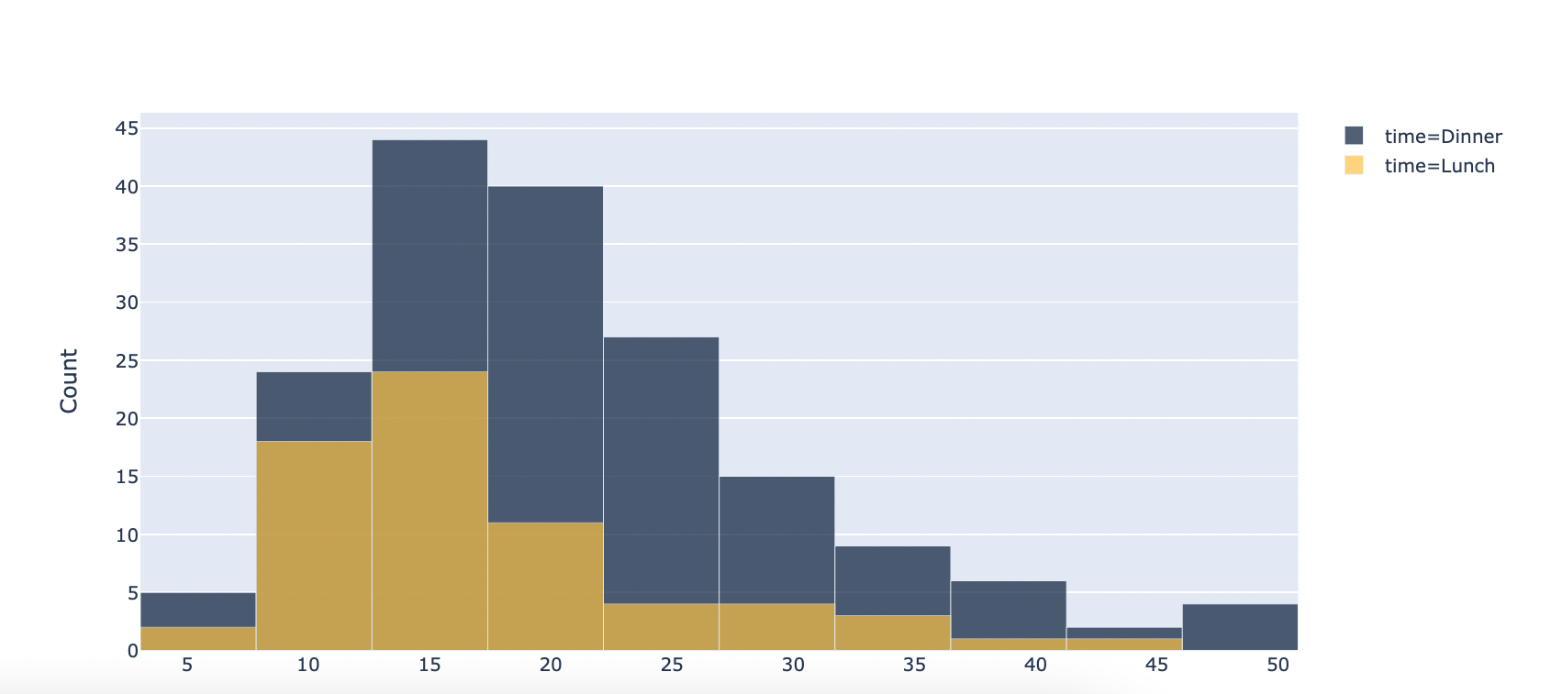
Example
It can be hard to compare two distributions if one has significantly more observations than the other.
When comparing distributions, compare the shape, not the absolute heights.

Slide 25
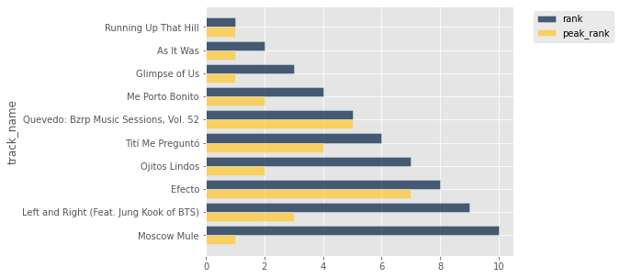
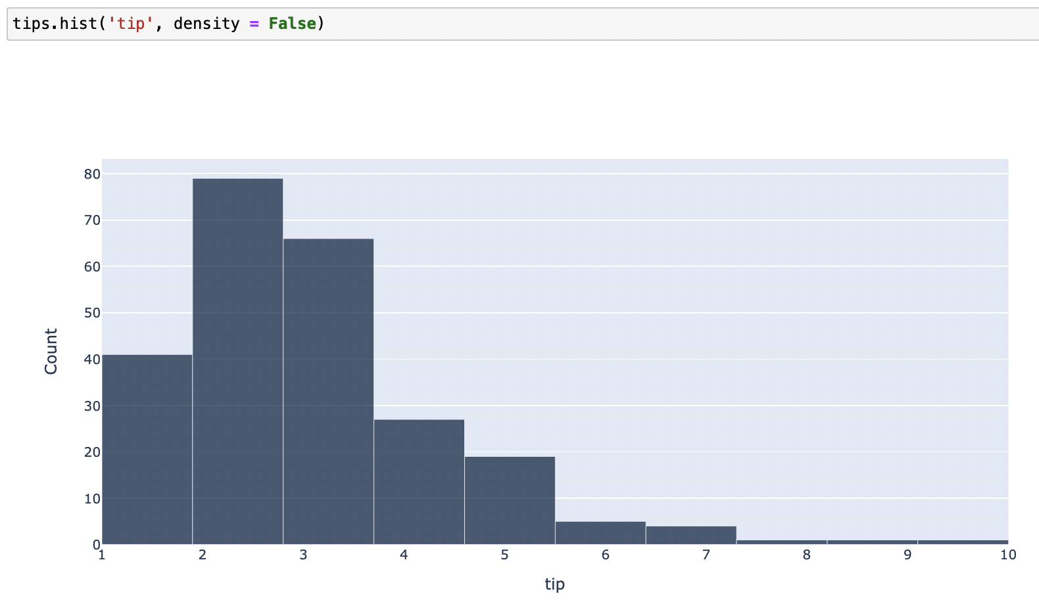
Bar Charts vs. Histograms
Bar charts visualize the distribution of a categorical variable, or the relationship between a categorical variable and a numerical variable.
Length of bar corresponds to value.
Width of bar means nothing.
Histograms visualize the distribution of a numerical variable.
Length of bar corresponds to number of values within bin.
Width of bar corresponds to the width of the bin.
Wider bin → more values within bin → smoother histogram.

Slide 26
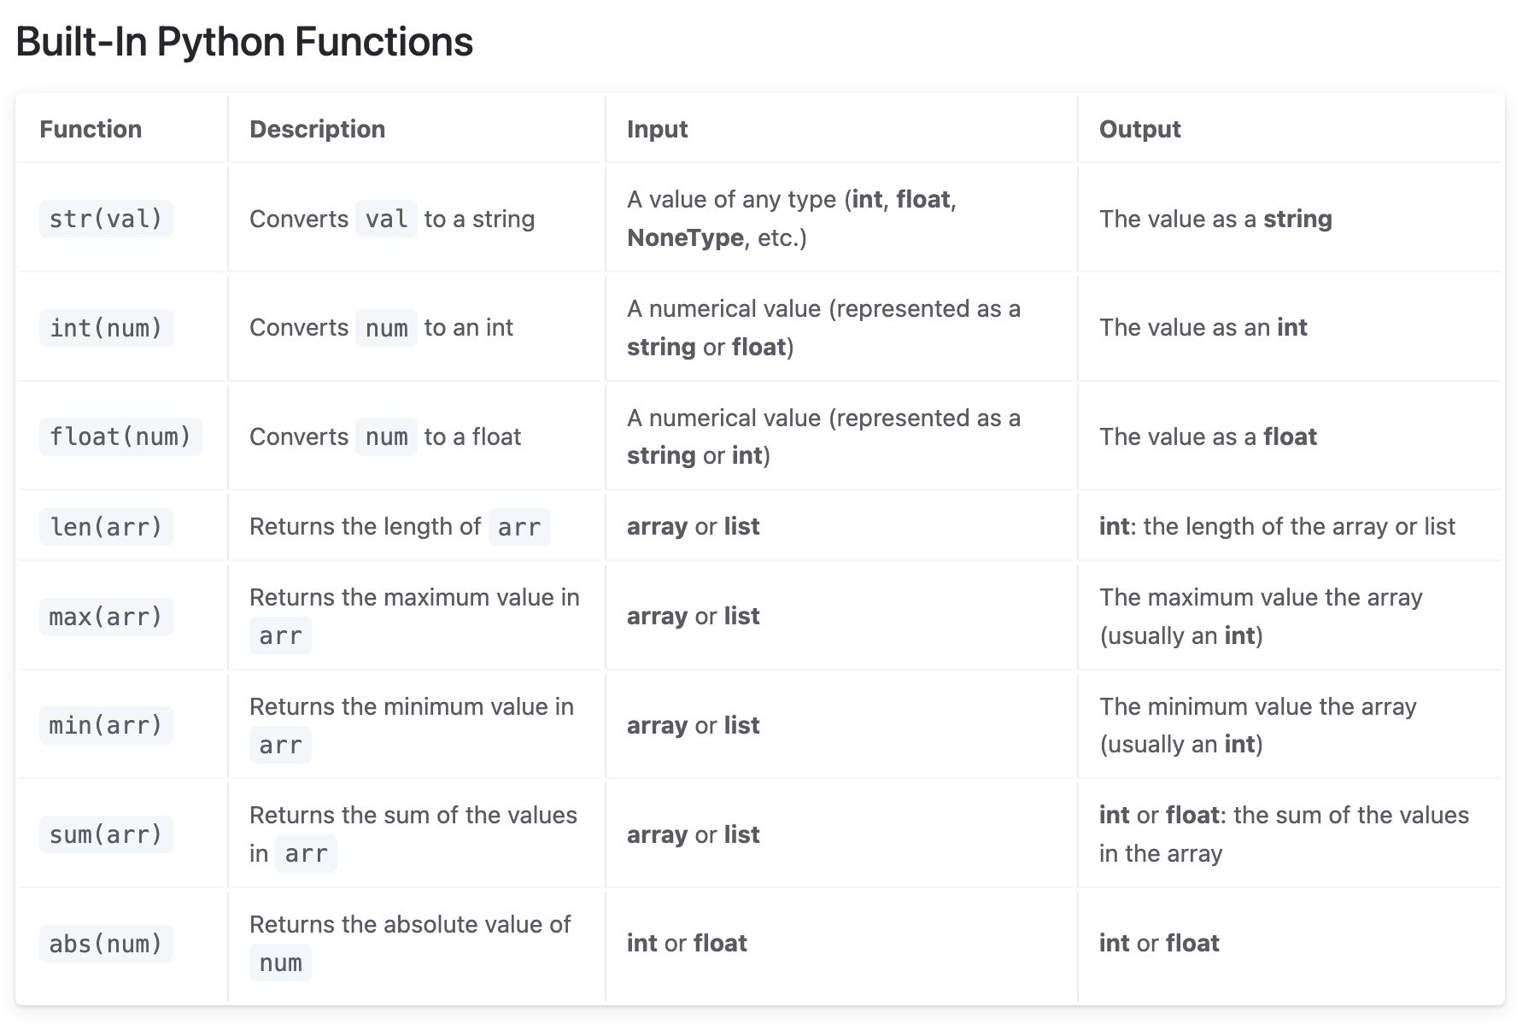
Questions About Functions?

Slide 27
In Conclusion…

Slide 28
Summary
A histogram visualizes the distribution of a numerical variable by binning. The method
plt.hist(column)
creates a histogram of the column column of t. This column must contain numerical values.
Optional arguments:
bins (array): allows us to manually select bins. Frequently used with np.arange.
alpha (float): allows us to have more transparent distributions
plt.show() can be used to include multiple distributions in the same histogram plot!

Slide 29
Recap
Next Time
Numerical Distributions
Histograms
Bins
Overlaid Plots
Visualizing Multiple Variables
Scatter Plots
Line Plots

Slide 30
Week ?
Announcements!
No Homework Due this week!
Mid-Semester Project will be announced soon/this week.
Will be similar to Homework #3
Will be due March 22
Office Hours take place
(Suzanne) Mondays 4:30 - 5:20PM in ACS 366
(Adrien) Wednesdays 4:30 - 5:20PM in ACS 330B
(Jordan) Tuesdays & Thursdays 10-12am

